Slide 1
NAME : Sojitra Devansh
ENROLL NO : 91900957046
BRANCH : ICT - Diplo
SEMSTER-1

Slide 2
HTML Website

Slide 3
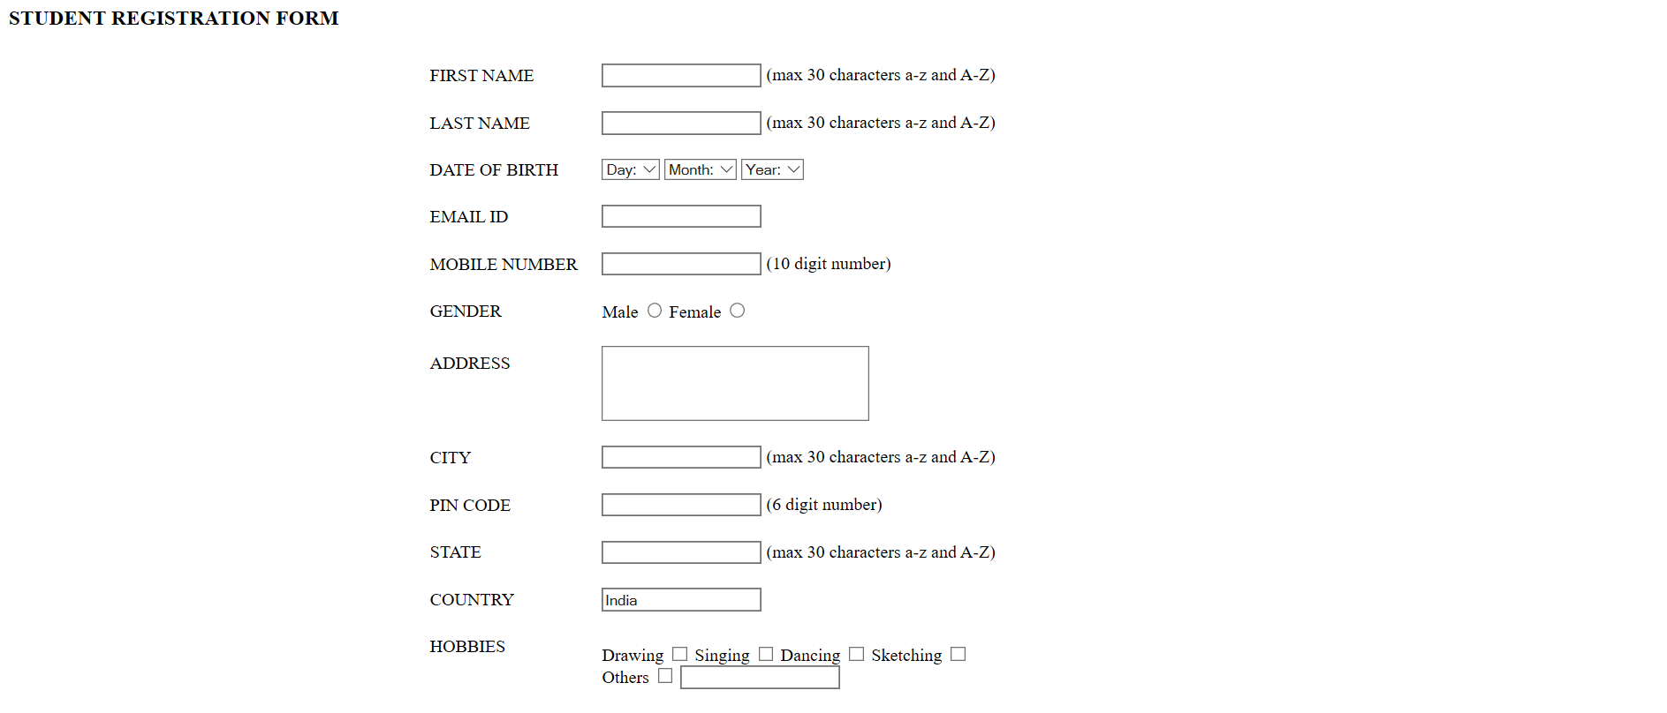
HTML Form
Output :

Slide 4
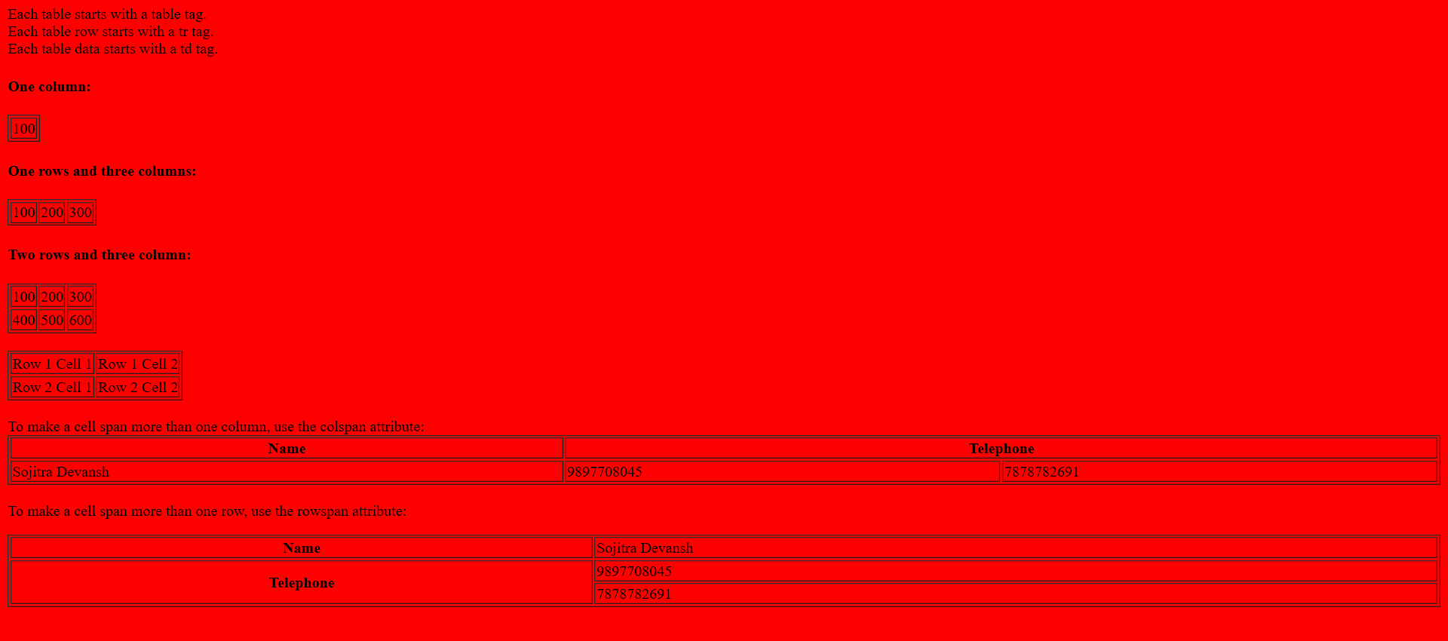
Table
Output :

Slide 5

Columns & Rows
Output :

Slide 6

Cell Spacing
Output :

Slide 7

Cell Padding
Output :

Slide 8
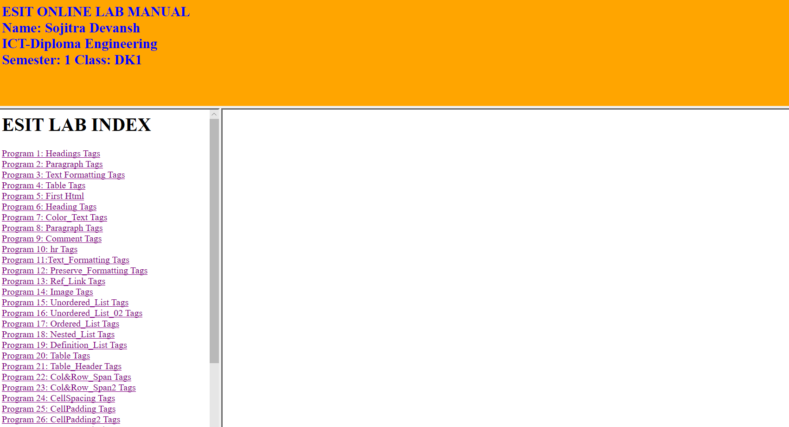
MainFrame
Output :

Slide 9
CSS (Cascading Style Sheet)

Slide 10
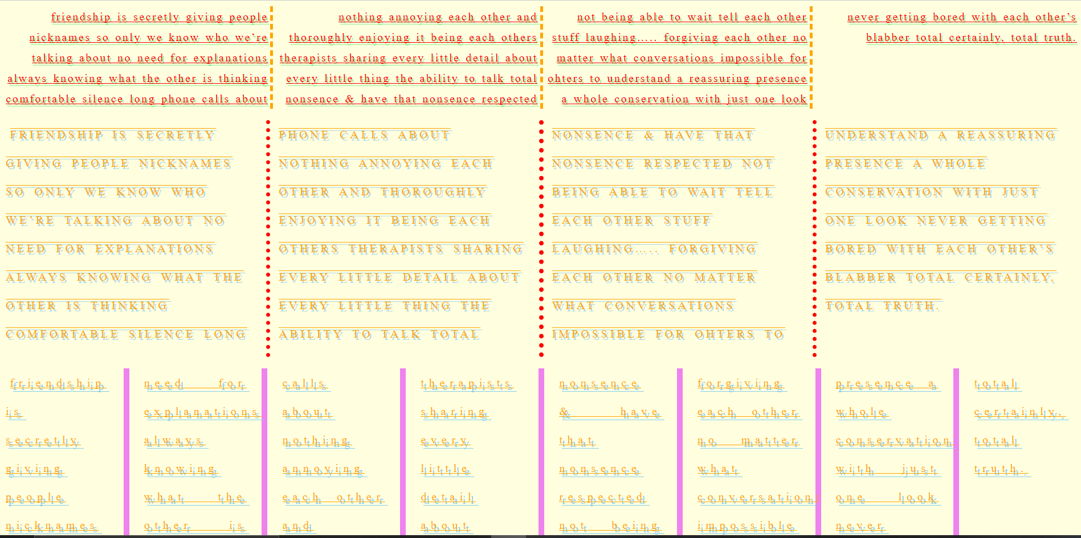
MultiColumn
Output :

Slide 11
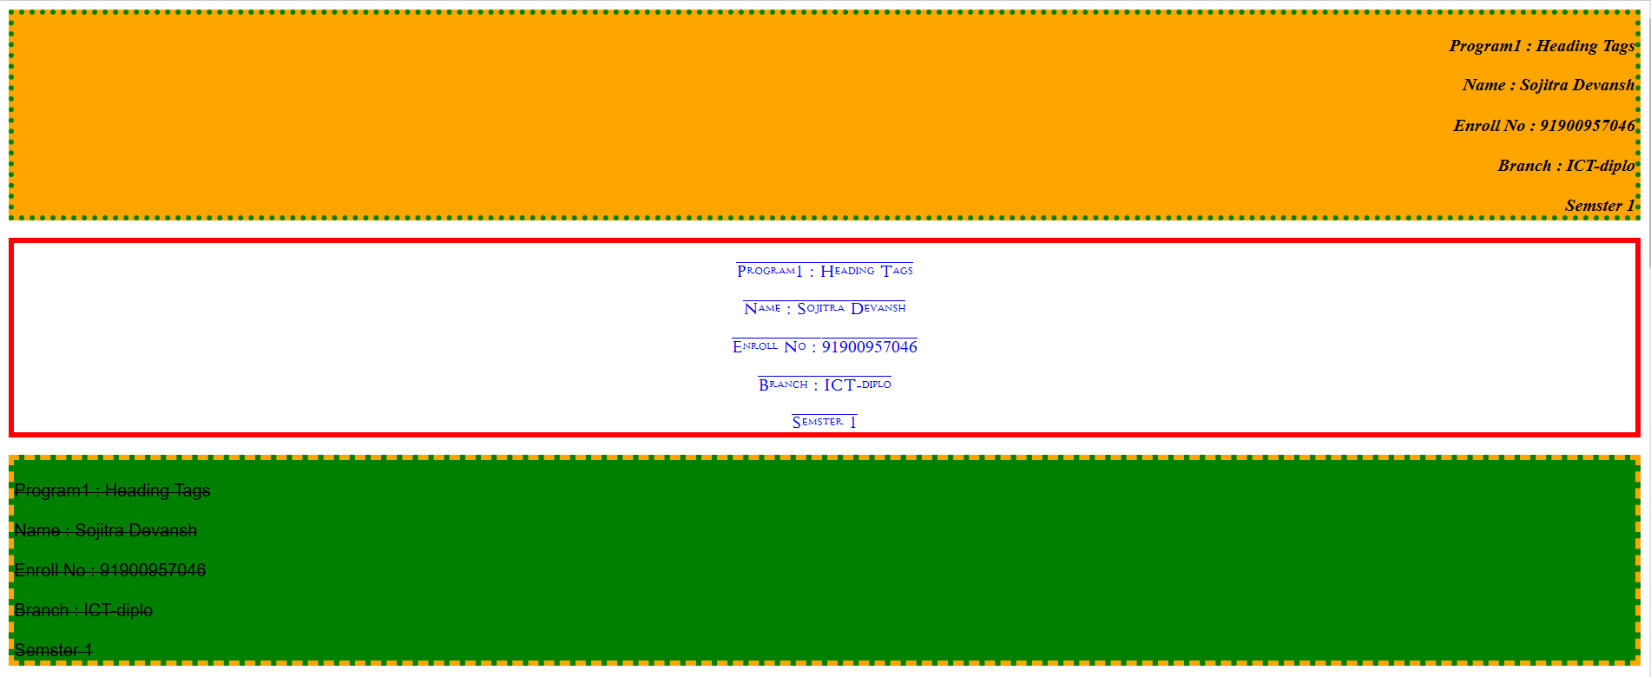
Borders & Fonts
Output :

Slide 12
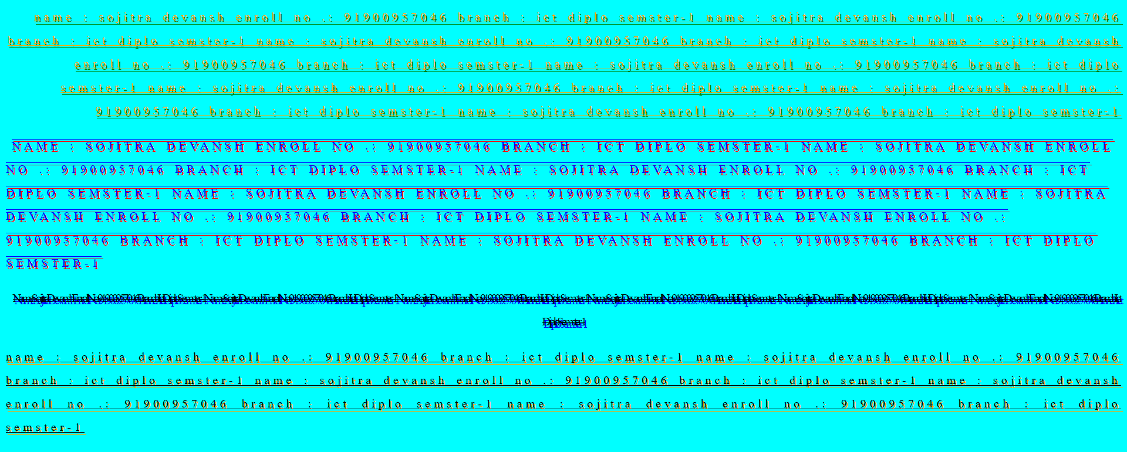
CSS Text
Output :

Slide 13
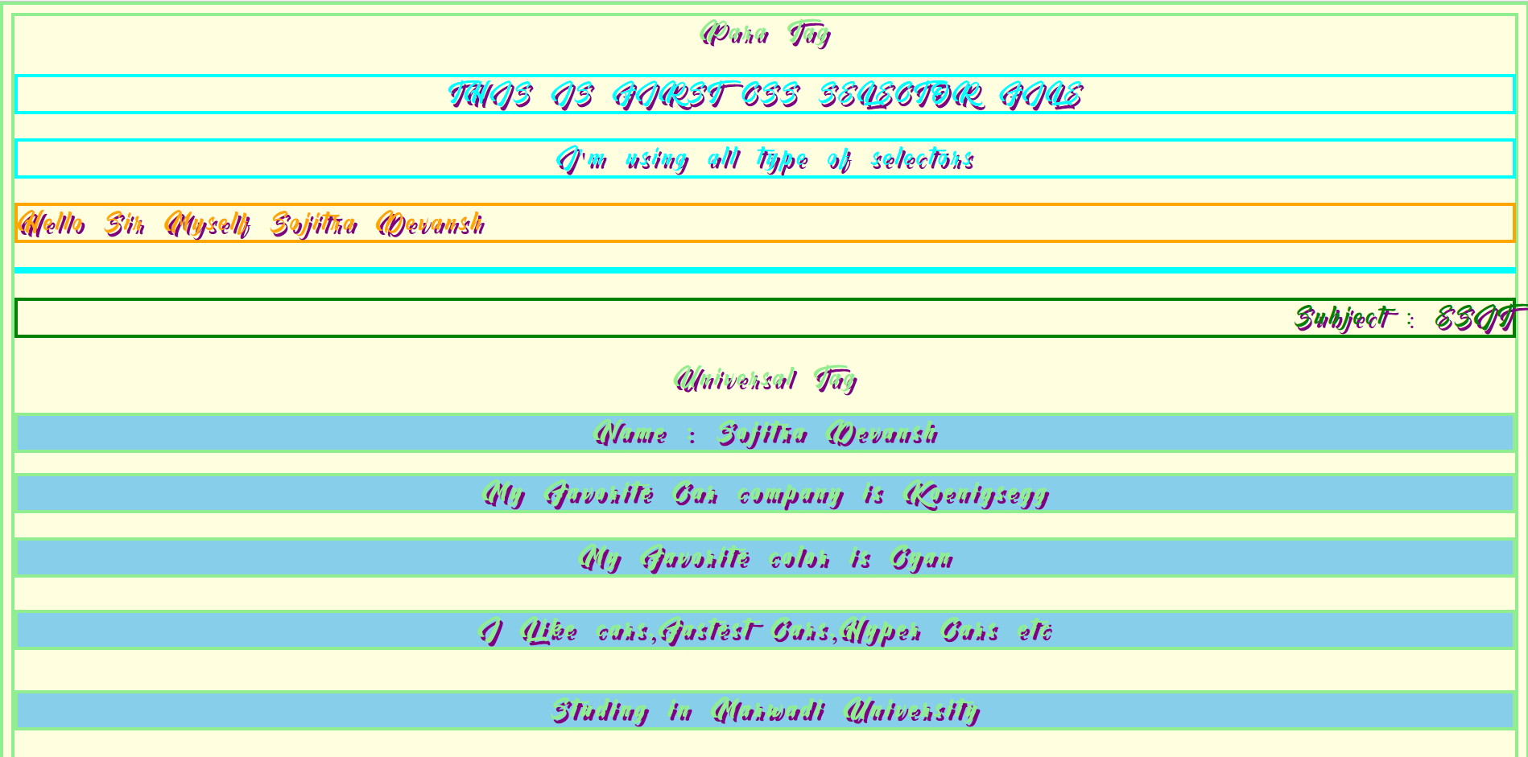
CSS Selectors
Output :

Slide 14
JavaScript

Slide 15
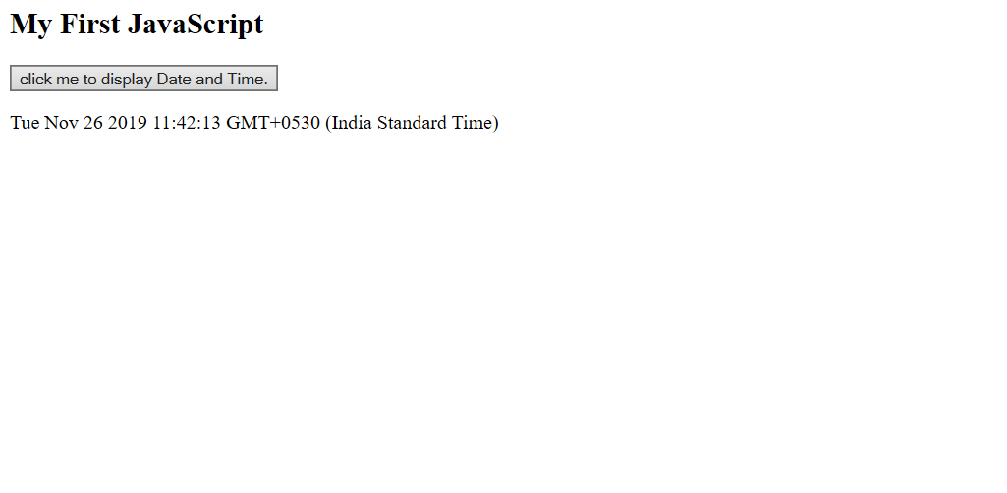
Date & Time
Output :

Slide 16
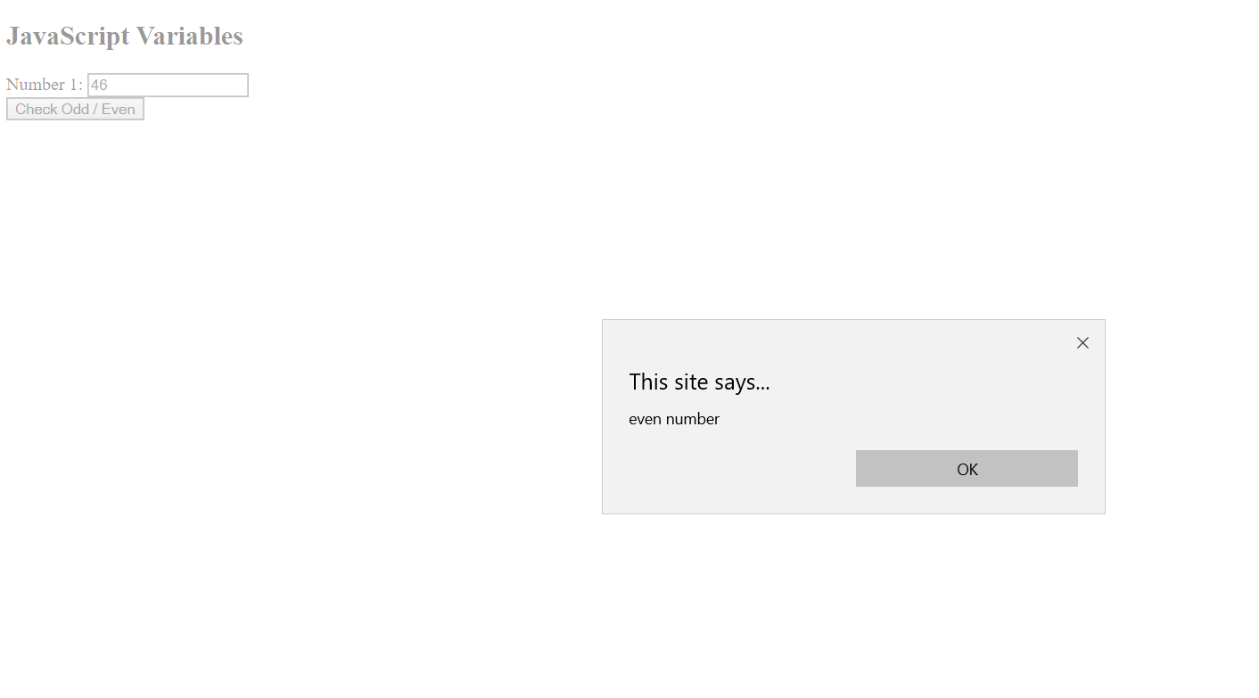
Variables
Output :

Slide 17
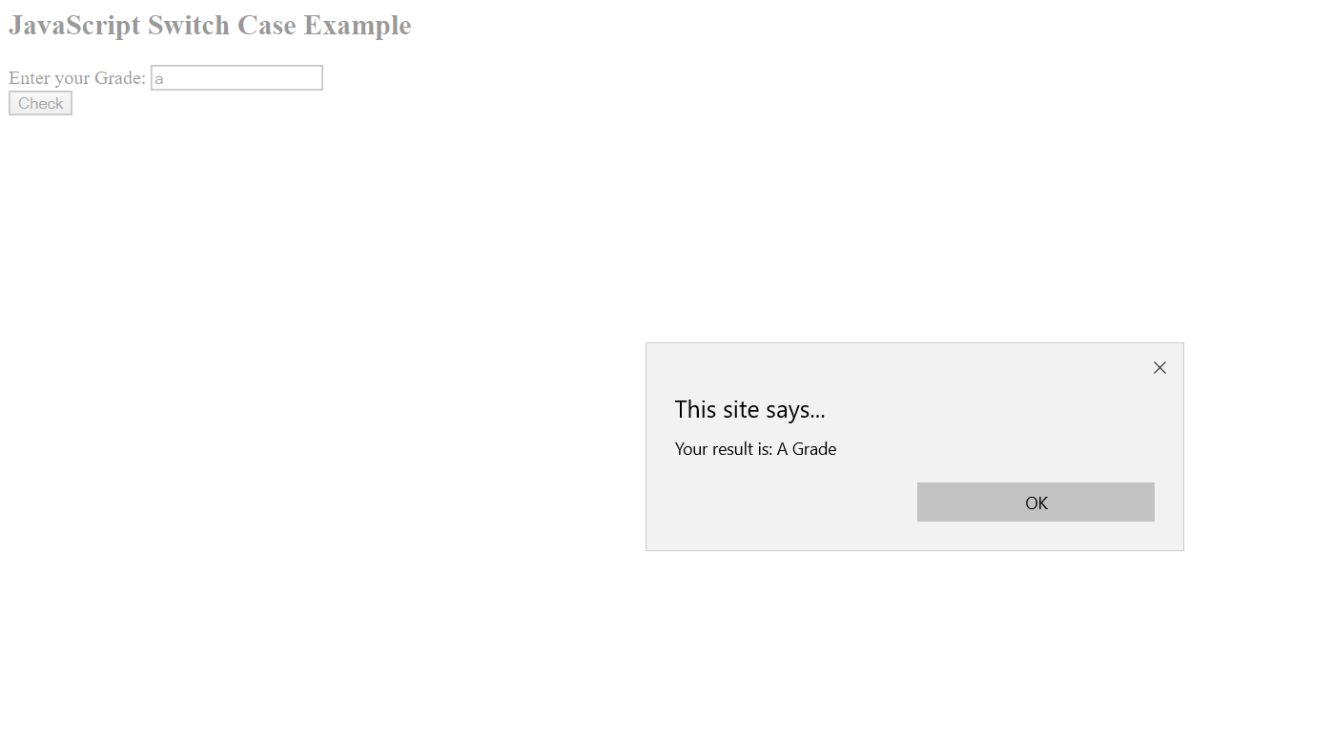
Switch Case Example
Output :

Slide 18

SoloLearn HTML Certificate

Slide 19

SoloLearn CSS Certificate

Slide 20
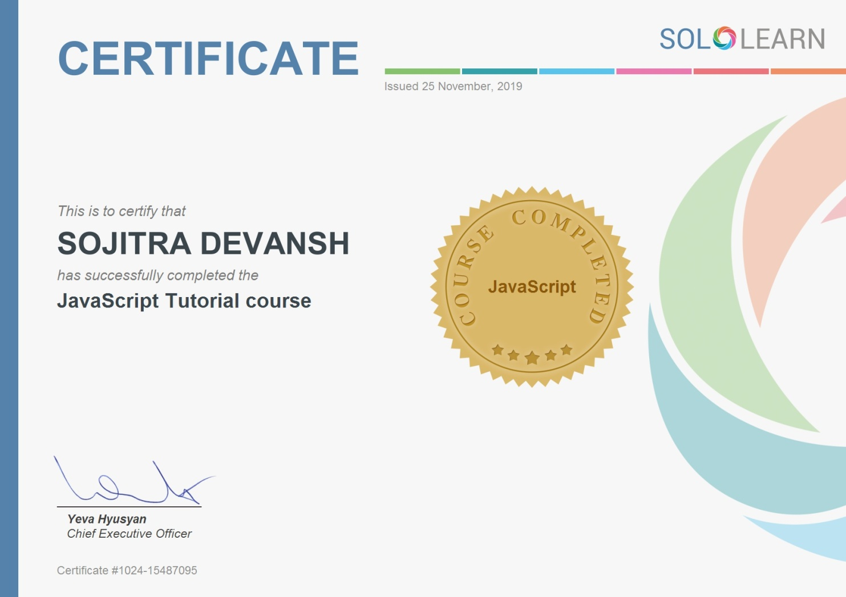
SoloLearn JavaScript Certificate

Slide 21
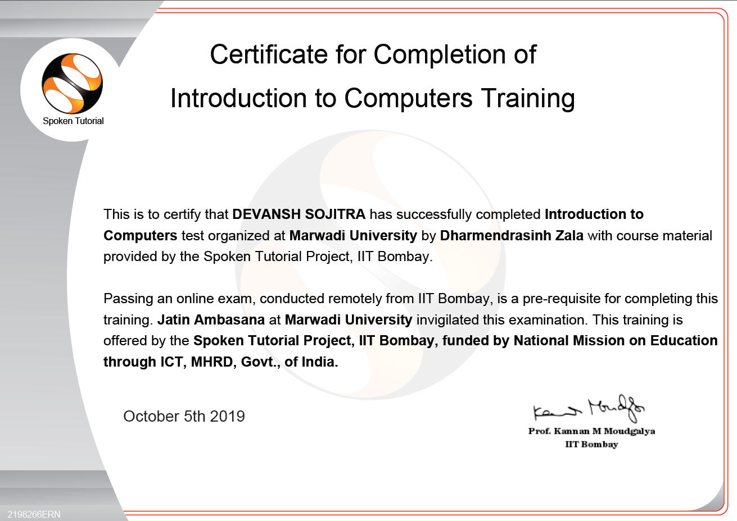
Spoken Tutorial Certificate

Slide 22
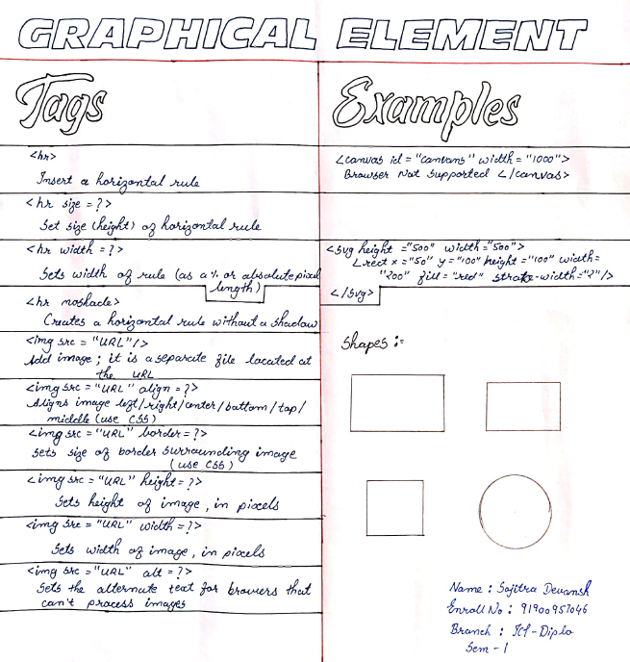
Cheat Sheet

Slide 23
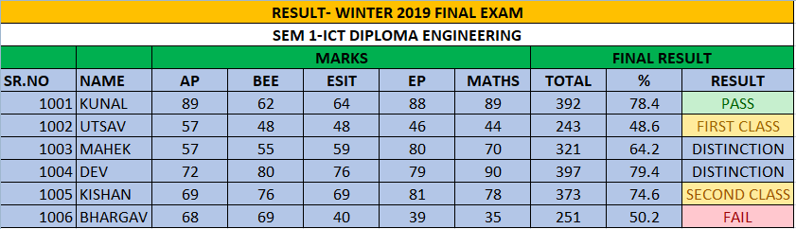
Spread Sheet

